Slide 1
Medical Image Analysis with computer vision
Matthew Engelhard

Slide 2
Overview
What can computer vision (CV) do, and how is it relevant to clinical medicine?
How does CV work, in brief?
How do we (re)-train a model to classify medical images?
Notes on image data pre-processing (time permitting)

Slide 3
Overview
What can computer vision (CV) do, and how is it relevant to clinical medicine?
How does CV work, in brief?
How do we (re)-train a model to classify medical images?
Take an existing, trained classification model
Replace the final layer (i.e., prediction head)
Fine-tune model parameters
Notes on image data pre-processing (time permitting)

Slide 4
What can computer vision do?
Classification, Detection, Segmentation…

Slide 5
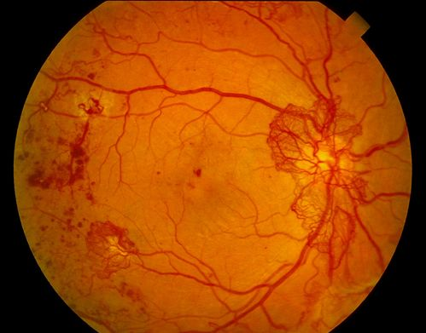
Binary Classification
Diabetic retinopathy? (Yes/No)
Gulshan et al. JAMA (2016)
Notes:
Ask for other examples

Slide 6

Multi-Class Classification
Image Label? (1000 classes)
Notes:
Contrast with binary case

Slide 7
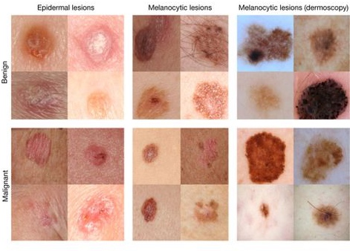
Multi-Class Classification
Dermatologist-level classification of skin cancer
Nature volume 542, pages 115–118 (02 February 2017)
Notes:
Could this be binary?
Could this be multi-class?
How many classes?

Slide 8
Object Detection
Notes:
Overcome limit of classification
Typically a limited number of classes
Describe output structure

Slide 9
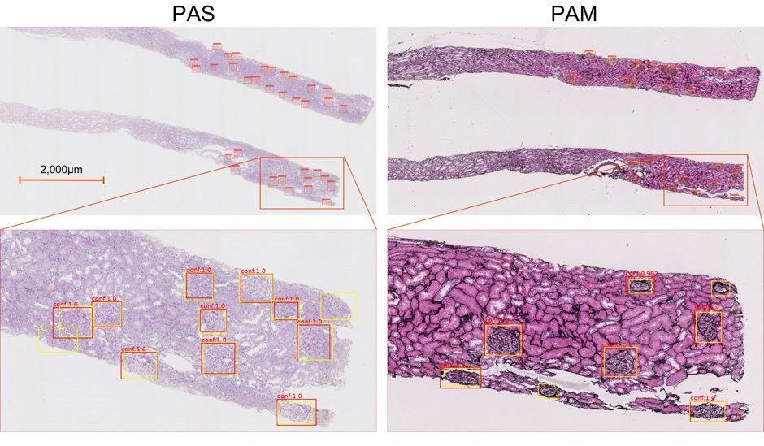
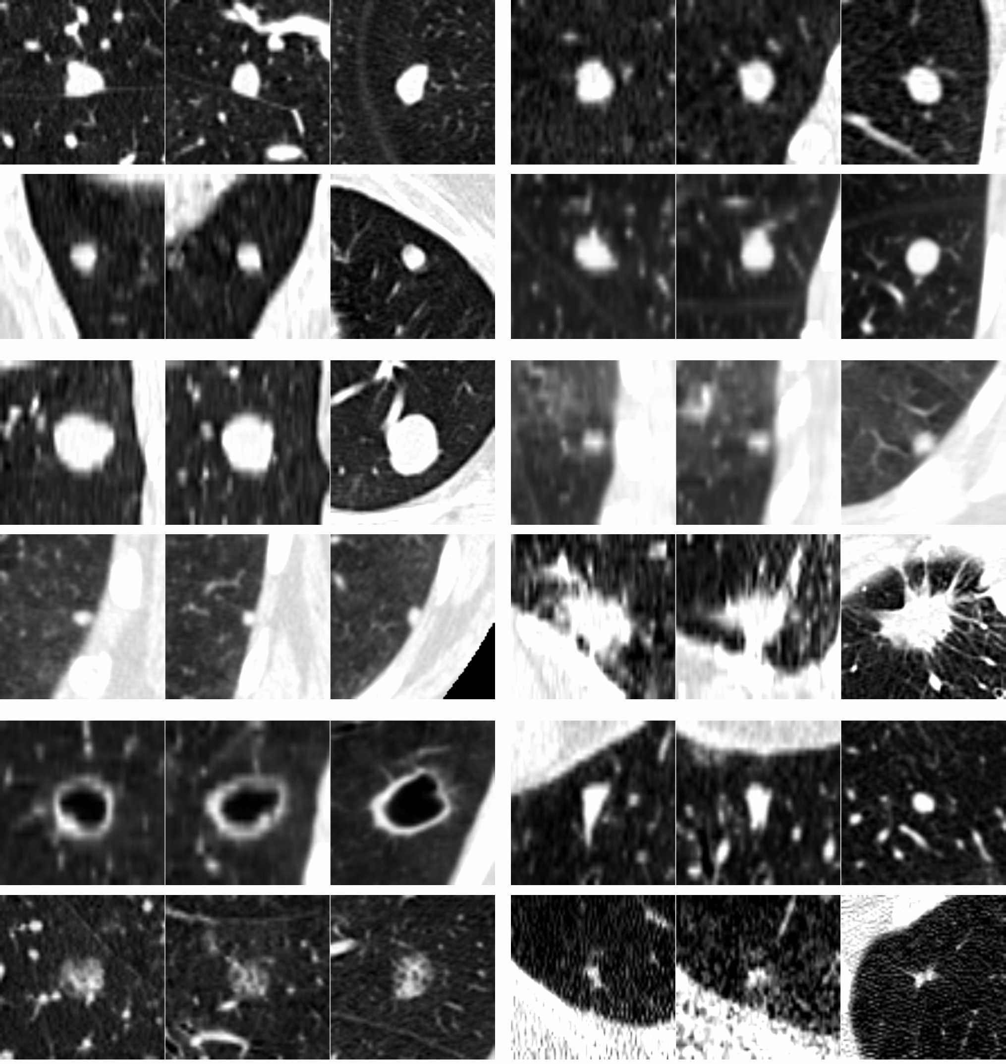
Object Detection in Medicine
Glomerular Detection with Faster-RCNN
Kawazoe et al., J. Imaging, 2018
Pulmonary Nodule detection in CT
van Ginneken et al., Biomedical Imaging, 2015
Notes:
Other examples in medicine?
High annotation cost

Slide 10
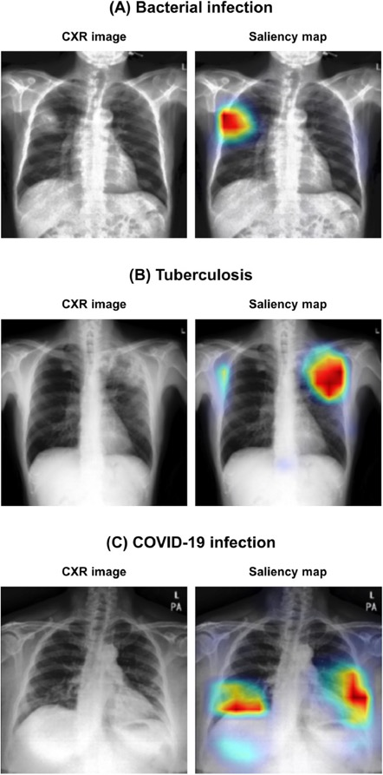
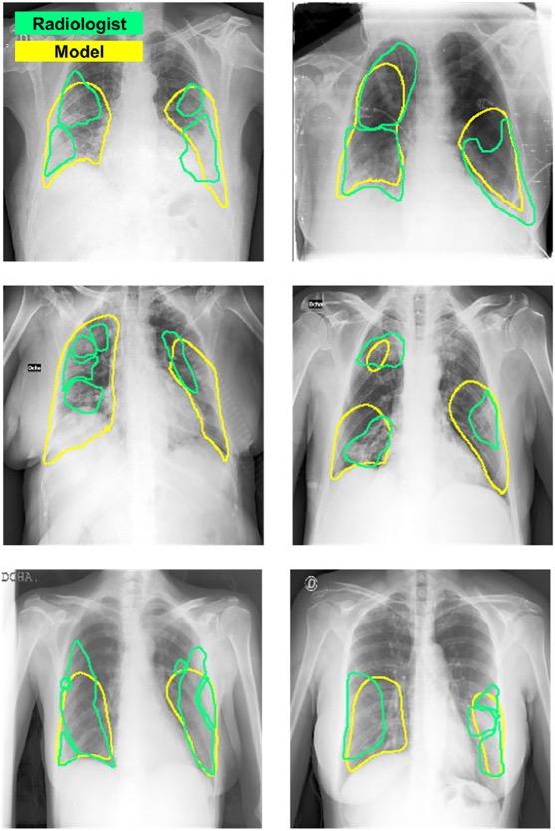
Localization via vision transformer (ViT)
Park S, Kim G, Oh Y, et al. Multi-task vision transformer using low-level chest X-ray feature corpus for COVID-19 diagnosis and severity quantification. Med Image Anal. 2022;75:102299.
-> Other Vision Applications

Slide 11
Semantic Segmentation
Notes:
Very high annotation cost
Does not distinguish between distinct objects

Slide 12
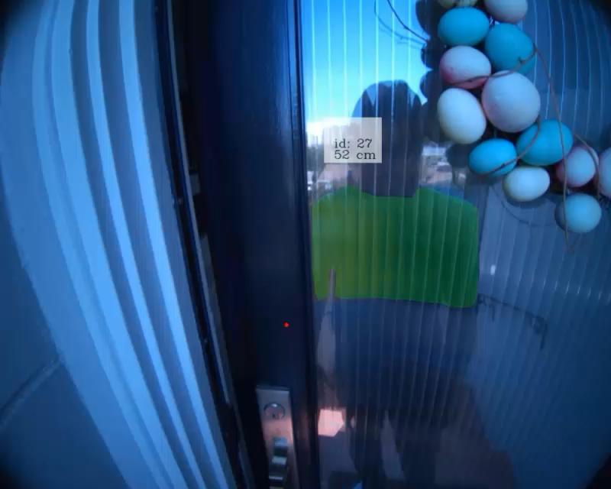
Segment Anything (even unfamiliar objects)
Kirillov, Alexander, et al. "Segment anything." arXiv preprint arXiv:2304.02643 (2023).
https://segment-anything.com
-> Other Vision Applications
Notes:
Over the past few years we’ve seen
- better performance
- more precise boundaries
- (most importantly) better ”zero-shot generalization”, in other words to unknown objects and settings

Slide 13
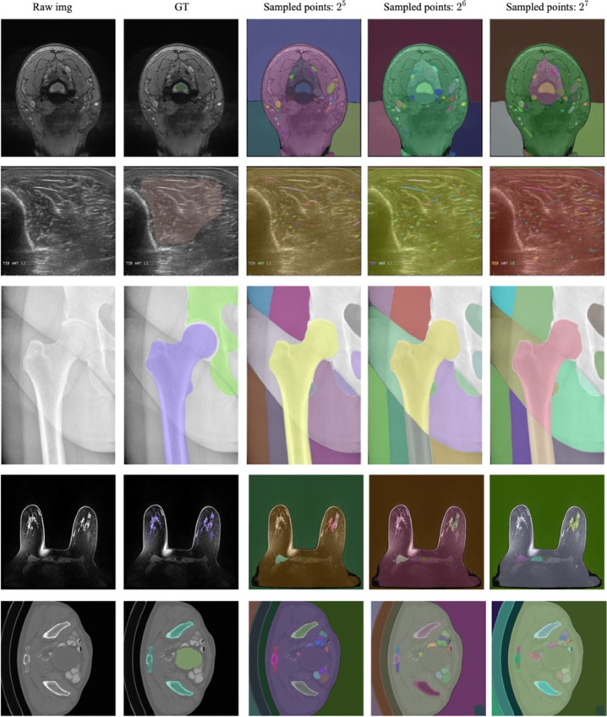
Segment Anything in Medical Images
Use Cases:
Precise identification of boundaries
Determine areas or volumes
Calculate features useful for subsequent analyses/models
Remove unwanted areas of images
Mazurowski, Maciej A., et al. "Segment anything model for medical image analysis: an experimental study." Medical Image Analysis 89 (2023): 102918.
-> Other Vision Applications
Notes:
The segment anything approach does in fact extend to medical images, as shown by AI Health’s own Maciej Mazurowski
Though they do note that performance is highly variable depending on the specific task
For example performing quite well for hip X-ray, as shown in the middle here, but poorly for spine MRI
ABSTRACT: Training segmentation models for medical images continues to be challenging due to the limited availability of data annotations. Segment Anything Model (SAM) is a foundation model trained on over 1 billion annotations, predominantly for natural images, that is intended to segment user-defined objects of interest in an interactive manner. While the model performance on natural images is impressive, medical image domains pose their own set of challenges. Here, we perform an extensive evaluation of SAM’s ability to segment medical images on a collection of 19 medical imaging datasets from various modalities and anatomies. In our experiments, we generated point and box prompts for SAM using a standard method that simulates interactive segmentation. We report the following findings: (1) SAM’s performance based on single prompts highly varies depending on the dataset and the task, from IoU=0.1135 for spine MRI to IoU=0.8650 for hip X-ray. (2) Segmentation performance appears to be better for well-circumscribed objects with prompts with less ambiguity such as the segmentation of organs in computed tomography and poorer in various other scenarios such as the segmentation of brain tumors. (3) SAM performs notably better with box prompts than with point prompts. (4) SAM outperforms similar methods RITM, SimpleClick, and FocalClick in almost all single-point prompt settings. (5) When multiple-point prompts are provided iteratively, SAM’s performance generally improves only slightly while other methods’ performance improves to the level that surpasses SAM’s point-based performance. We also provide several illustrations for SAM’s performance on all tested datasets, iterative segmentation, and SAM’s behavior given prompt ambiguity. We conclude that SAM shows impressive zero-shot segmentation performance for certain medical imaging datasets, but moderate to poor performance for others. SAM has the potential to make a significant impact in automated medical image segmentation in medical imaging, but appropriate care needs to be applied when using it. Code for evaluation SAM is made publicly available at https://github.com/mazurowski-lab/segment-anything-medical-evaluation.

Slide 14
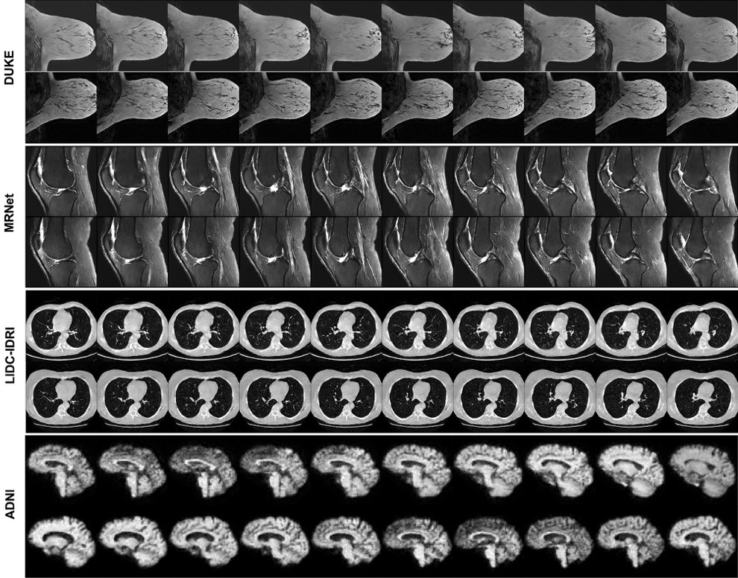
Generation of Synthetic Medical Images
Use cases:
Privacy / data sharing
Enrich dataset, e.g. to achieve broader coverage of physiologic variability
Anomaly detection
Image denoising
Khader, F., Müller-Franzes, G., Tayebi Arasteh, S. et al. Denoising diffusion probabilistic models for 3D medical image generation. Sci Rep 13, 7303 (2023).
-> Other Vision Applications

Slide 15
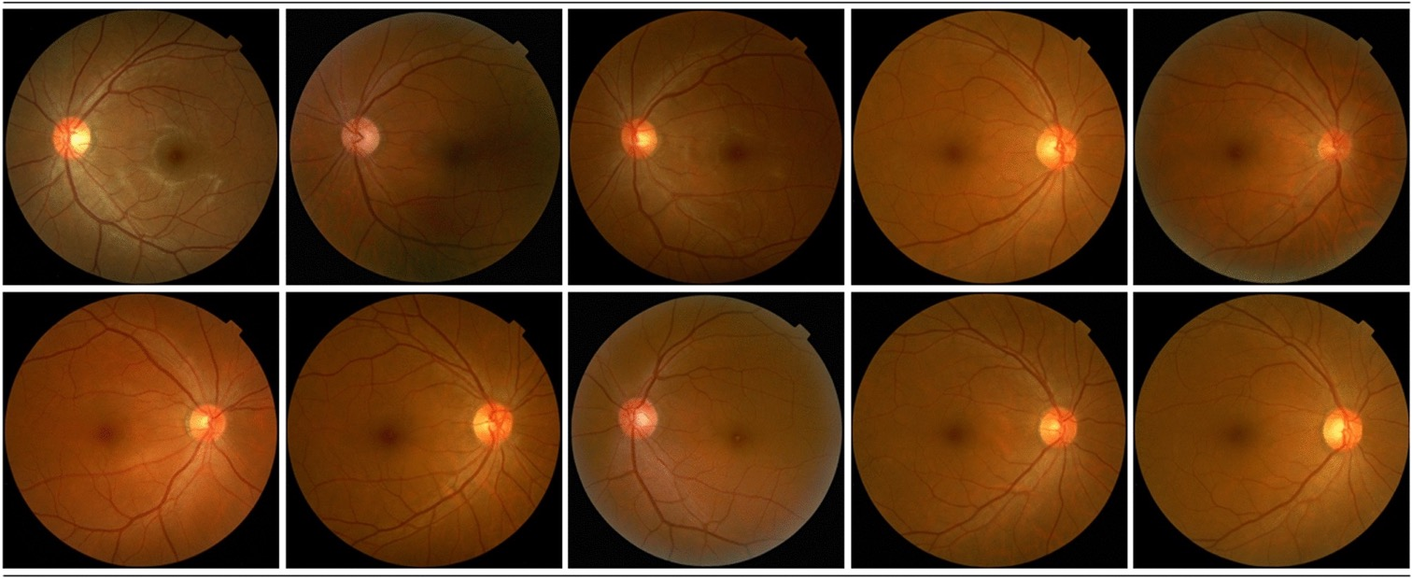
Generation of Synthetic Medical Images
Kim, M., Kim, Y.N., Jang, M. et al. Synthesizing realistic high-resolution retina image by style-based generative adversarial network and its utilization. Sci Rep 12, 17307 (2022).
-> Other Vision Applications

Slide 16
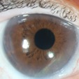
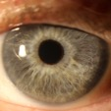
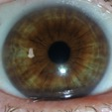
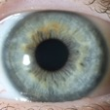
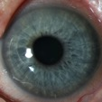
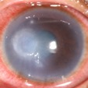
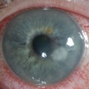
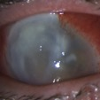
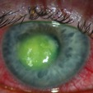
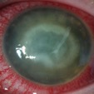
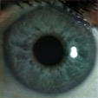
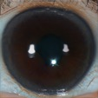
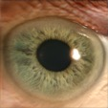
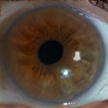
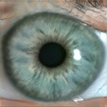
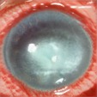
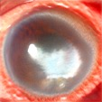
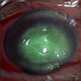
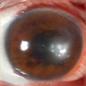
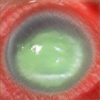
Often predictive and generative models are complementary.
Real Healthy (n=57)
Real Diseased (n=27).
Synthetic Healthy.
Synthetic Diseased.
Microbial keratitis (MK) detection:
Learn to generate synthetic data (generative)
Train an MK detection model (predictive)
(Daniel Wang et al., IOVS 2024;65:ARVO Abstract 2362)
Notes:
Daniel Wang
Anthony Kuo
Duke eye center!

Slide 17
What do these have in common? fine-tuning
Predictions are made with a convolutional neural network (CNN)*, which is a neural network with convolutional (rather than fully-connected) layers.
These models are not trained from scratch. Instead of beginning with random parameters, we begin with parameters learned from a different, usually non-medical task.
Why is this a good idea?
How can we develop our own CNN model?
*or in some cases, a vision transformer
Notes:
Note alternatives to CNN

Slide 18
How do CNNs work?
Hierarchical feature extraction (like the MLP).
Notes:
Intuitive perspective
Interactive
More details in async

Slide 19
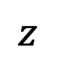
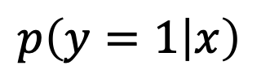
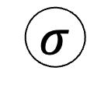
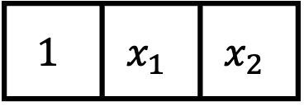
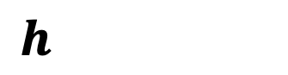
Recall: the MLP
$$p\left(y=1 | x\right)$$
$$σ$$
$$z$$
The MLP allowed us to detect complex, nonlinear features…
older male OR younger female
high OR low blood pressure
specific patient profiles
different handwritten digit styles
…by first identifying simpler features.
The model makes predictions about the complex features based on which simple features are detected.
Hidden Layer
$$h$$
$$1$$ | $$x_{1}$$ | $$x_{2}$$
Intercept
Age >60
Sex
Notes:
We can do this because h and \sigma(h) are always the same size!

Slide 20
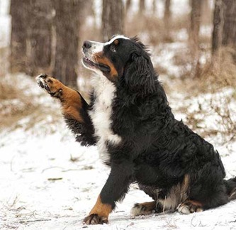
The relationship between individual pixels and the outcome is not linear.
y, associated value or label
x, data/features for a subject or patient
End goal: predict y from x
Notes:
Let’s contrast that with image processing
Want a model that identifies “Bernese Mountain dog”
What are the predictors here?
First: a single pixel has little to do with the outcome
Second: pixels are arranged in a meaningful way – not true of the previous model

Slide 21
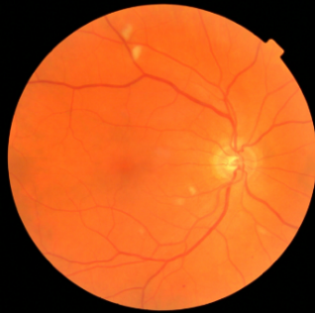
The relationship between individual pixels and the outcome is not linear.
y, associated value or label
x, data/features for a subject or patient
End goal: predict y from x
Notes:
The same is true for medical images
Thinking about this fundoscopic image, does it really matter whether a specific pixel is light versus dark?
What matters are the pixels in relation to one another.
Together they form vessels, suggest exudates, comprise the optic disk – but in isolation, they are near meaningless

Slide 22
We must build a hierarchy of features.
low-level motifs
high-level motifs
dog
label
pixels
End goal: predict dog from pixels
Notes:
In APACHE we can go straight from predictors to label
here we have to build up our understanding of the image bit by bit.
pixels… → lines, arcs, textures
lines and arcs → shapes, contours
Shapes, contours → paw, ear, eye
Paw, ear, eye → dog
All these patterns – we call them motifs
And they are arranged in a hierarchy

Slide 23
We must build a hierarchy of features.
high-level motifs are
specific arrangements
of low-level motifs
low-level motifs
high-level motifs
dog
edges
shapes
textures
eyes
ears
paws
label
pixels
End goal: predict dog from pixels
Notes:
Hinton:
“If there were simple rules”… it wouldn’t have taken us until 2012 to figure this out.
So, is there a simple rule you can use to determine whether a dog is present?
Maybe…. If the rule can be in terms eyes, ears, and paws
Rule for paws is based on shapes
Rule for shapes is based on pixels

Slide 24
We must build a hierarchy of features.
low-level motifs
high-level motifs
retinopathy
edges
shapes
textures
microaneurysm
exudates
hemorrhage
label
pixels
End goal: predict retinopathy from pixels
Notes:
what might features at different levels of THIS hierarchy look like?
top level: retinopathy
high level: microaneurysms, exudates, hemorrhage, etc…
mid level: blood vessels, retinal textures, etc.
Low level: edges, curves, etc. same as before!

Slide 25
We must build a hierarchy of features.
low-level motifs are common to all naturalistic images…
low-level motifs
high-level motifs
retinopathy
edges
shapes
textures
microaneurysm
exudates
hemorrhage
label
pixels
End goal: predict retinopathy from pixels
Notes:
the high level stuff is very different when talking about retina versus talking about dog.
But the low level stuff, that’s common to all images.
And so, when we learn these models, we have to learn the high level stuff anew each time.
But how to detect the low level stuff -- that we can just remember from other models.

Slide 26
Why start with a pre-trained model?
Instead of beginning with random parameters, we begin with parameters learned from a different, usually non-medical task.
This is because these parameters are better than random: many features that are helpful in classifying naturalistic images are also helpful in classifying medical images.
This is particularly true early in the feature hierarchy (i.e. low-level motifs; early layers).

Slide 27
How do we build our CNN?
Copy, modify, fine-tune. We will focus on whole-image classification.

Slide 28
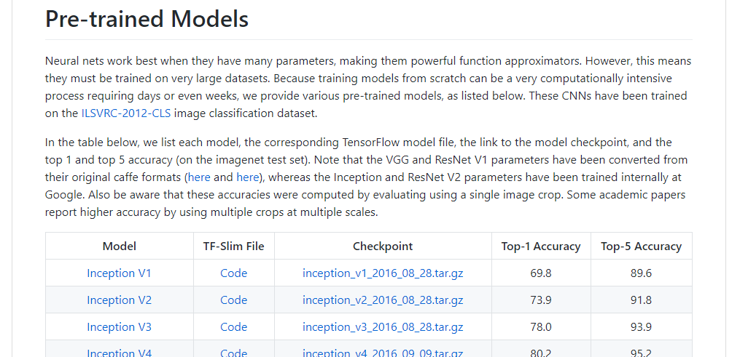
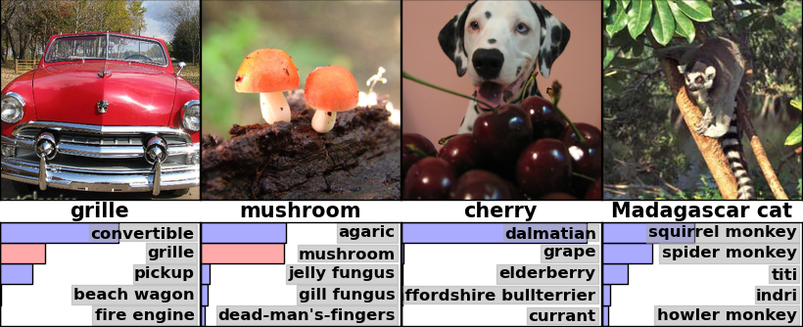
Step 1. Download a trained image classification model.
Python Code:
Defines the model architecture
Checkpoint File:
Contains parameters of the trained model
https://github.com/tensorflow/models/tree/master/research/slim#Pretrained
Notes:
CODE -> architecture
CHECKPOINT -> parameters

Slide 29
We can divide this model into two pieces:
retinopathy
label
A CNN image encoder that converts the raw image to a vector of high-level motifs / features.
A final layer, or prediction head – this is a logistic regression model – that makes predictions about the label from these high-level features.
We will reuse the encoder but replace the prediction head, since it is specific to the previous (non-medical) task.
vector of high-
level features
CNN
Encoder
image

Slide 30
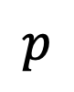
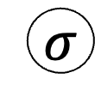
(Enhance!) Inspecting the prediction head:
$$p$$
Predicted probability of retinopathy
In this example, our prediction head is simple logistic regression on the features extracted by the CNN encoder.
$$σ$$
z
Predicted log-odds
of retinopathy
vector of high-
level features
CNN
Encoder

Slide 31

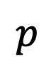
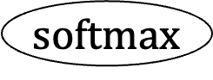
(Enhance!) Inspecting the prediction head:
$$p$$
Predicted probability of dog, cat, fish
In this example, our prediction head is simple logistic regression on the features extracted by the CNN encoder.
Typically, we start with a multi-class (rather than binary) prediction head.
$$softmax$$
Softmax function
(i.e. multi-class sigmoid)
z
Predicted log-odds
of dog, cat, fish
vector of high-
level features
CNN
Encoder

Slide 32
Step 2: Replace the prediction head.
$$p$$
Predicted probability of dog, cat, fish
In this example, our prediction head is simple logistic regression on the features extracted by the CNN encoder.
Typically, we start with a multi-class (rather than binary) prediction head.
We want to make predictions about a new set of labels, so we cut off the prediction head…
$$softmax$$
Softmax function
(i.e. multi-class sigmoid)
z
Predicted log-odds
of dog, cat, fish
vector of high-
level features
CNN
Encoder

Slide 33
Step 2: Replace the prediction head.
In this example, our prediction head is simple logistic regression on the features extracted by the CNN encoder.
Typically, we start with a multi-class (rather than binary) prediction head.
We want to make predictions about a new set of labels, so we cut off the prediction head…
vector of high-
level features
CNN
Encoder

Slide 34
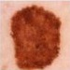
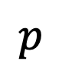
Step 2: Replace the prediction head.
Predicted probability of melanoma, carcinoma, keratosis, nevus
$$p$$
In this example, our prediction head is simple logistic regression on the features extracted by the CNN encoder.
Typically, we start with a multi-class (rather than binary) prediction head.
We want to make predictions about a new set of labels, so we cut off the prediction head…
…and replace it with a new one appropriate for our new prediction task.
$$softmax$$
z
Predicted log-odds of melanoma, carcinoma, keratosis, nevus
vector of high-
level features
CNN
Encoder

Slide 35
Step 3: Train it on your data.
Finally, you train the model with your dataset of medical images.
You train the same way you’d train any other model.*
The prediction head is new, so parameters in this layer are learned entirely from your data.
The CNN encoder is not new, so we say parameters in the encoder are fine-tuned to your data.
You’ll need a big dataset (e.g. 1k), but since you started with a pre-trained model, not as big as if you trained from scratch (e.g. 1M).
This process (steps 1-3) is called transfer learning.
*with a few caveats

Slide 36
Some notes on fine-tuning:
fine-tuning a pre-trained model tends to be at least as good as learning from scratch
(empirical result)
2) freeze early layers and fine-tune later layers
more data → fine-tune more layers
3) best tuning depth depends on the application, and should be explored as a hyperparameter
Notes:
~130k images -> they fine-tune all layers

Slide 37
Image Data Preprocessing
…also called data augmentation

Slide 38
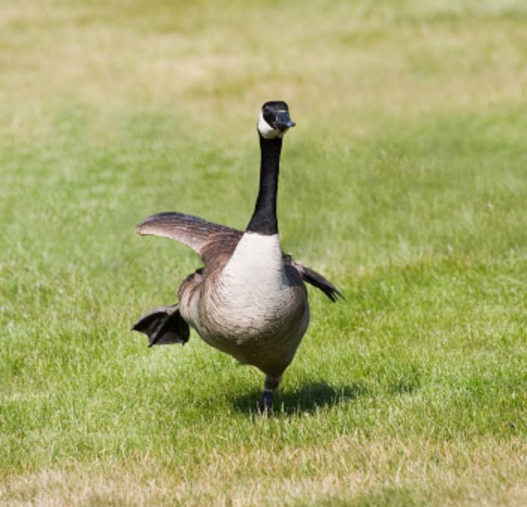
CNN: I know this one, it’s a goose!

Slide 39
CNN: I have no idea what this is.

Slide 40
CNN: I’ve never seen anything like this in my life.

Slide 41
CNN: I don’t see anything.

Slide 42
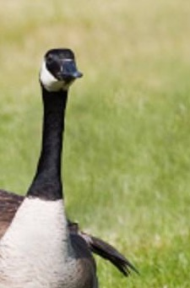
CNN: I think this is a space shuttle.

Slide 43
Solution: Augment your dataset
Apply random rotations, crops, brightness adjustments, stretching, etc
The details depend on the application.

Slide 44
Summary
CNNs can classify images or detect objects within images, including medically relevant findings.
CNNs work through hierarchical extraction of increasingly complex features.
We can re-purpose a trained CNN to classify medical images by:
Finding and downloading code and parameters defining the existing model
Replacing the final layer (i.e., prediction head) with a new one suitable for our task
Training the model with our dataset to learn parameters in the prediction head and fine-tune parameters in the CNN encoder
Applying random rotations, crops, brightness adjustments, etc during training makes the model robust to these variations if/when they are encountered

